Slide 1
bug buster
Danish Ahmad 19f0170
Muhammad Zain 19f0228
Talha Ahmad 19f0113

Slide 2
Iteration-01
“Layer architecture, CRUD operations, IDAL test cases and connection with database”

Slide 3
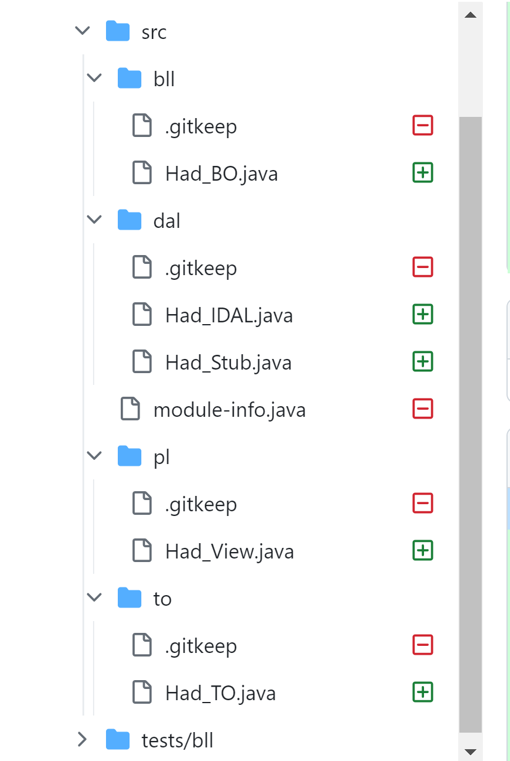
“Layer architecture”
In our first iteration, the first thing we did was we follow the layer architecture in java. By creating different layers as bll (business logic layer), dal (data access layer), pl (presentation layer) and to (transfer object).

Slide 4
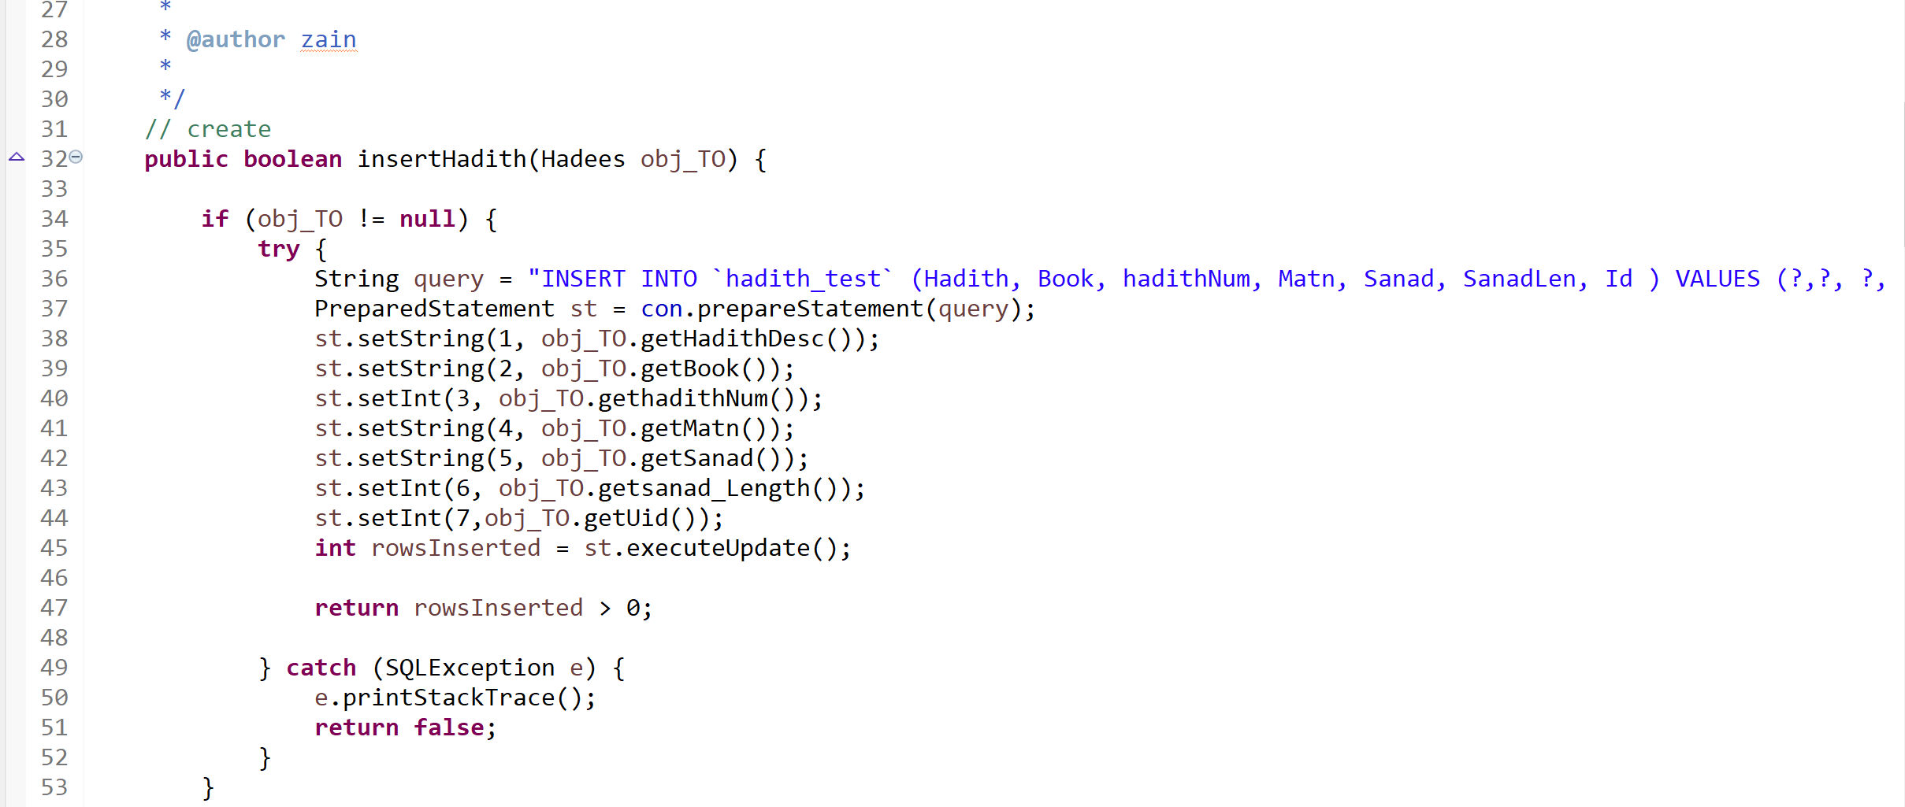
“Create Function”

Slide 5
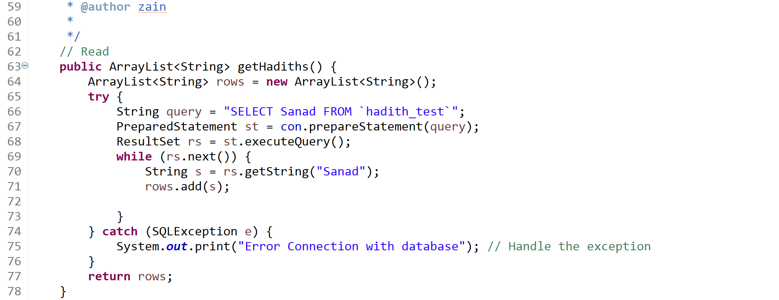
“Read Function”

Slide 6
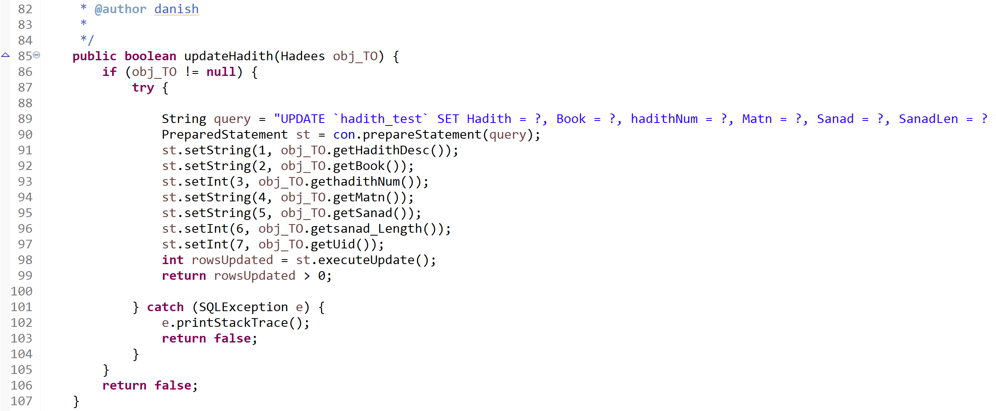
“Update Function”

Slide 7
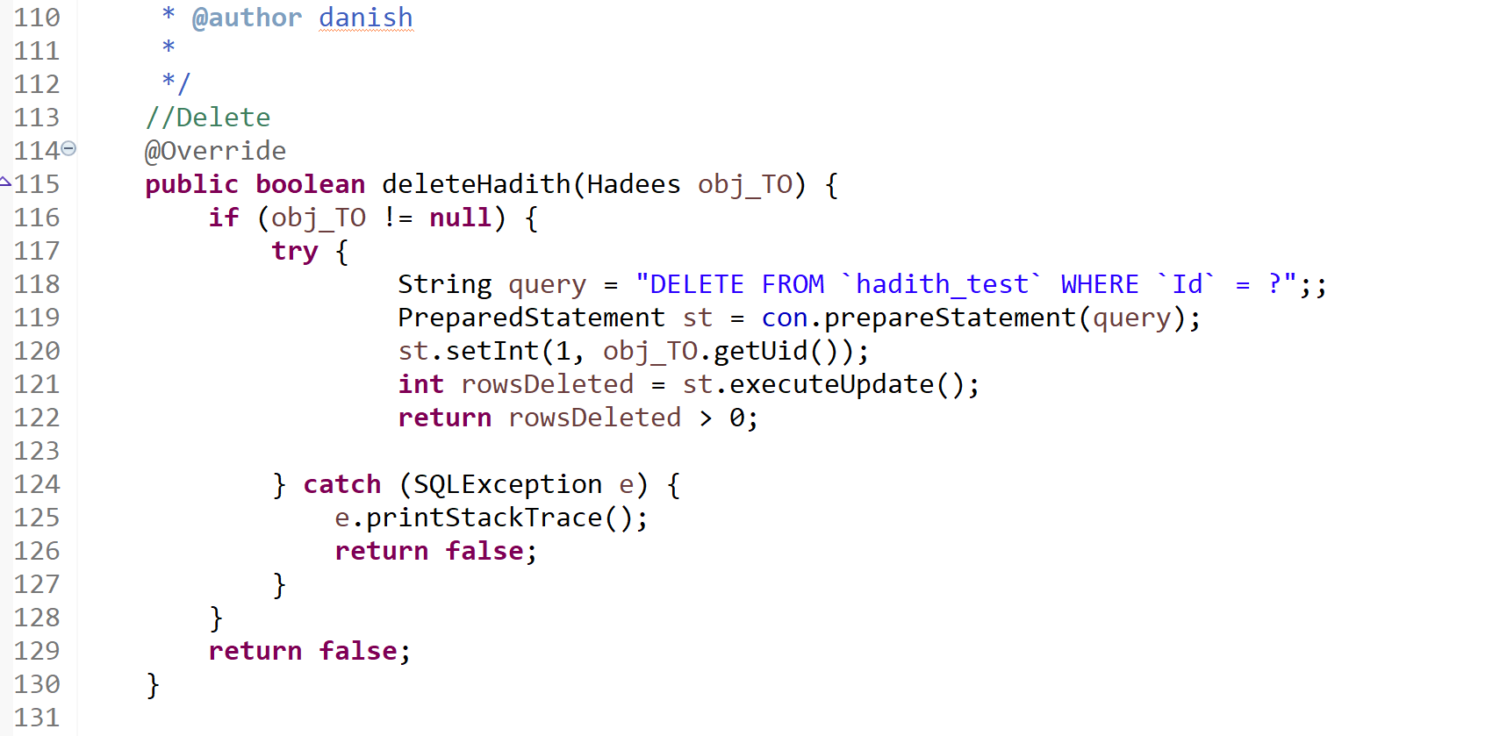
“Delete Function”

Slide 8
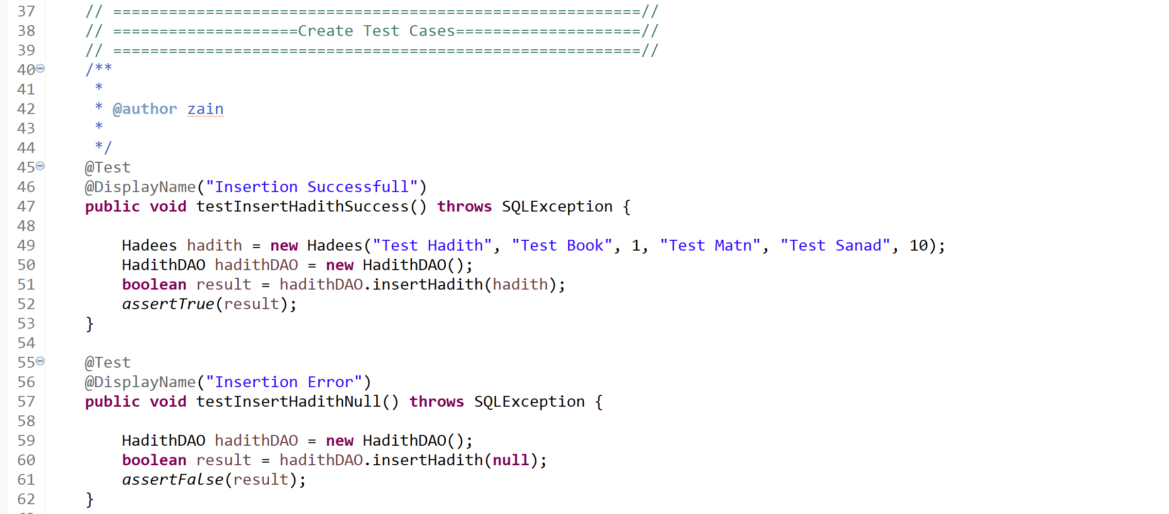
“IDAL test cases”

Slide 9
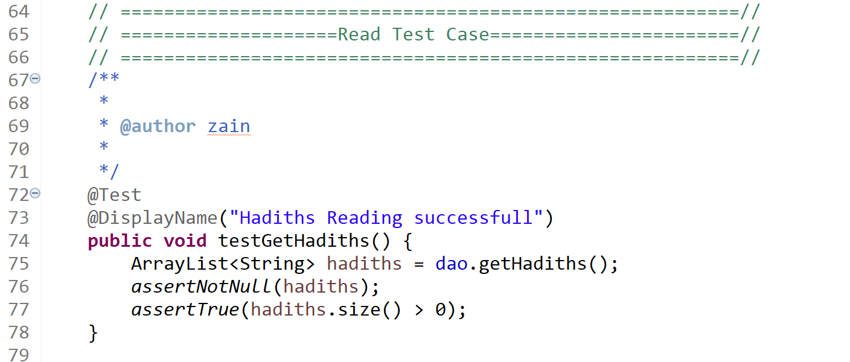
“IDAL test cases”

Slide 10
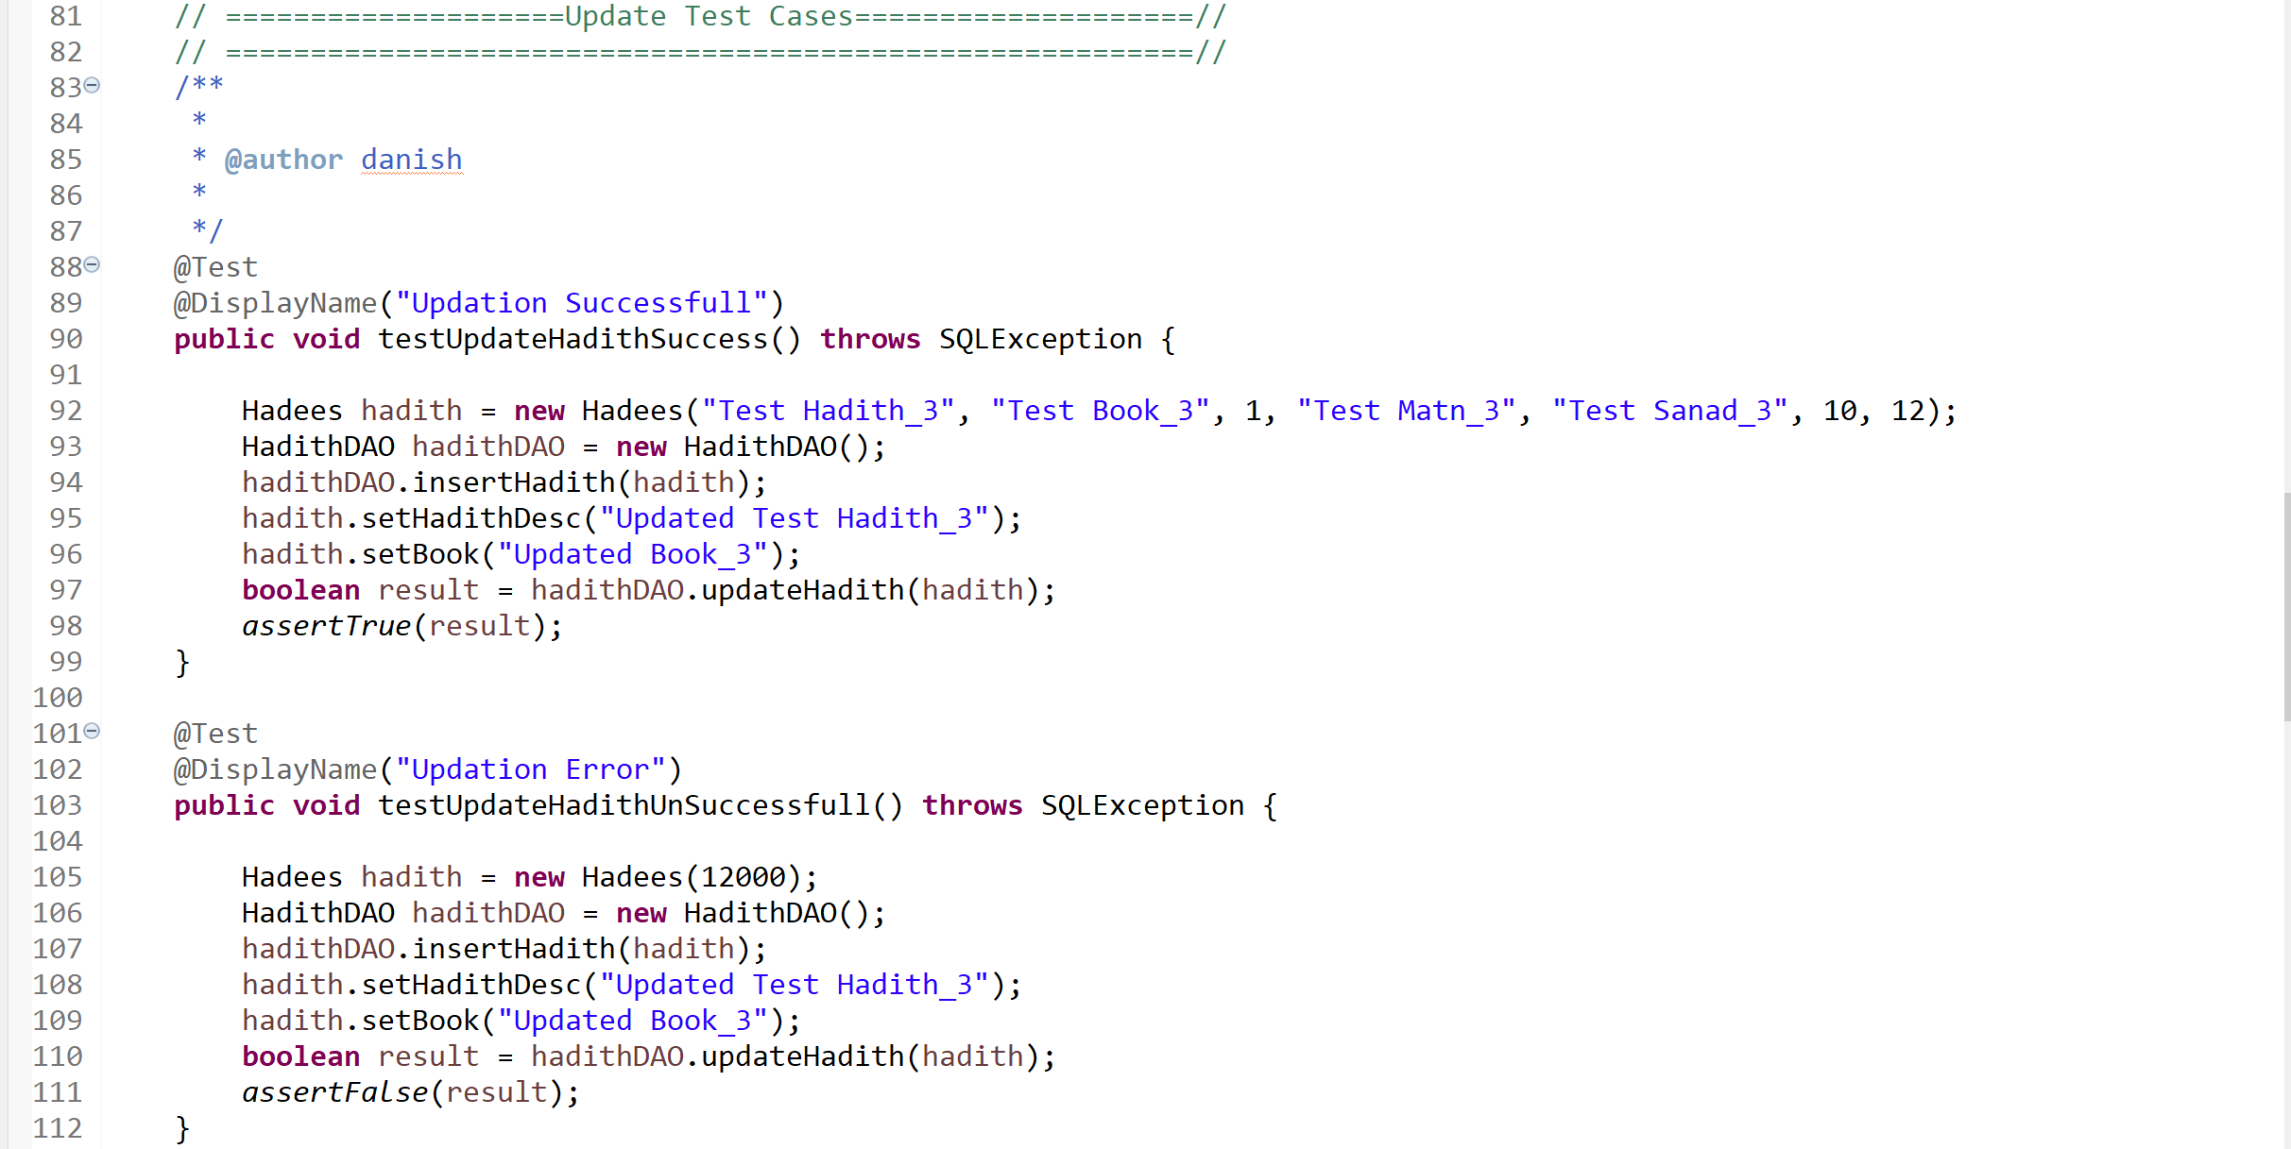
“IDAL test cases”

Slide 11
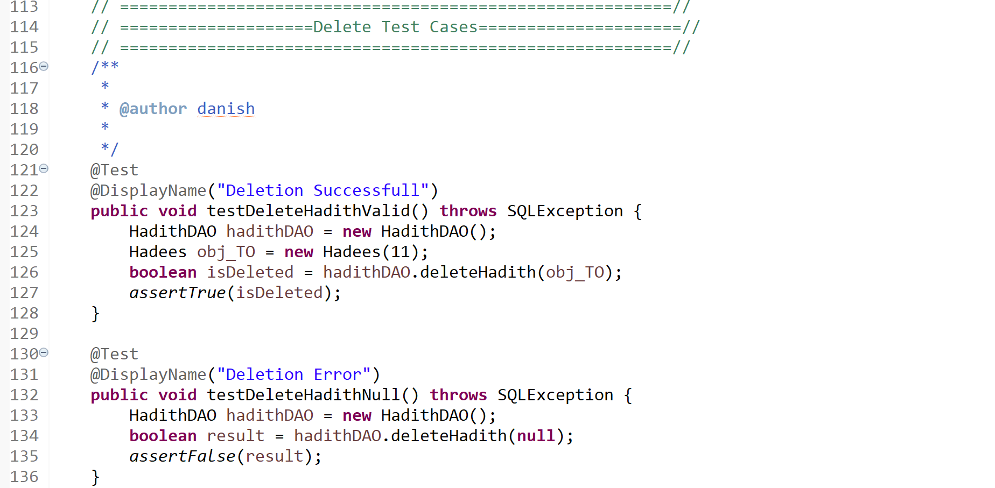
“IDAL test cases”

Slide 12
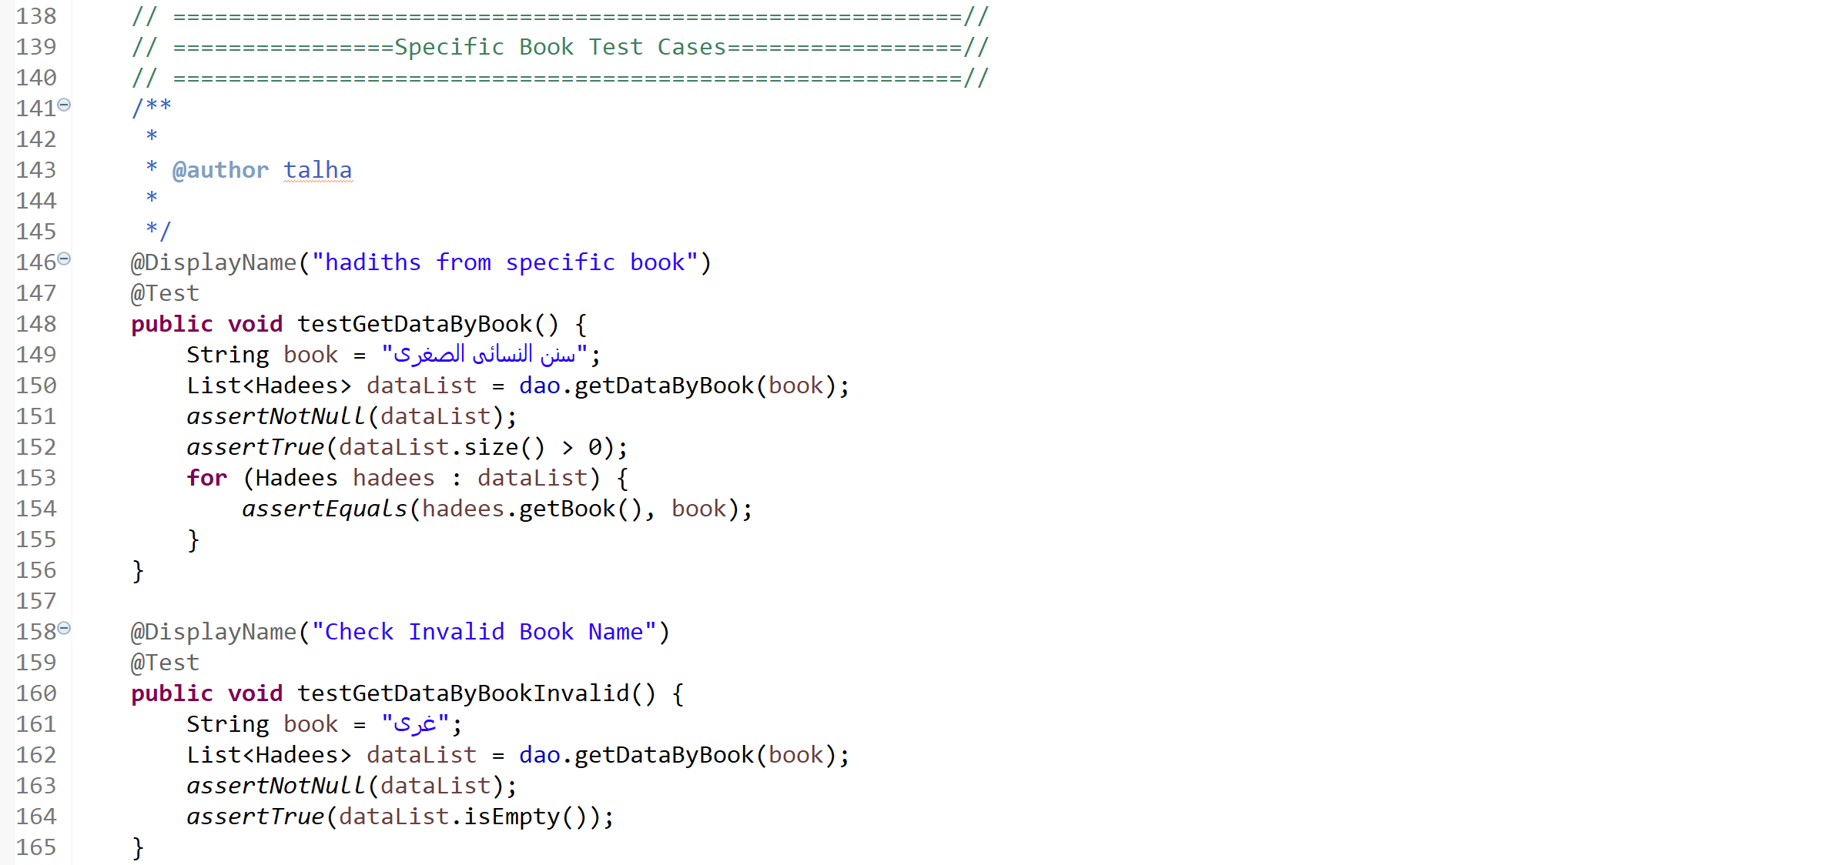
“IDAL test cases”

Slide 13
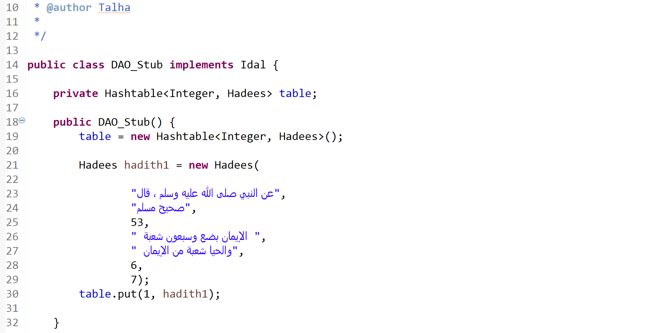
“DAO Stub”

Slide 14
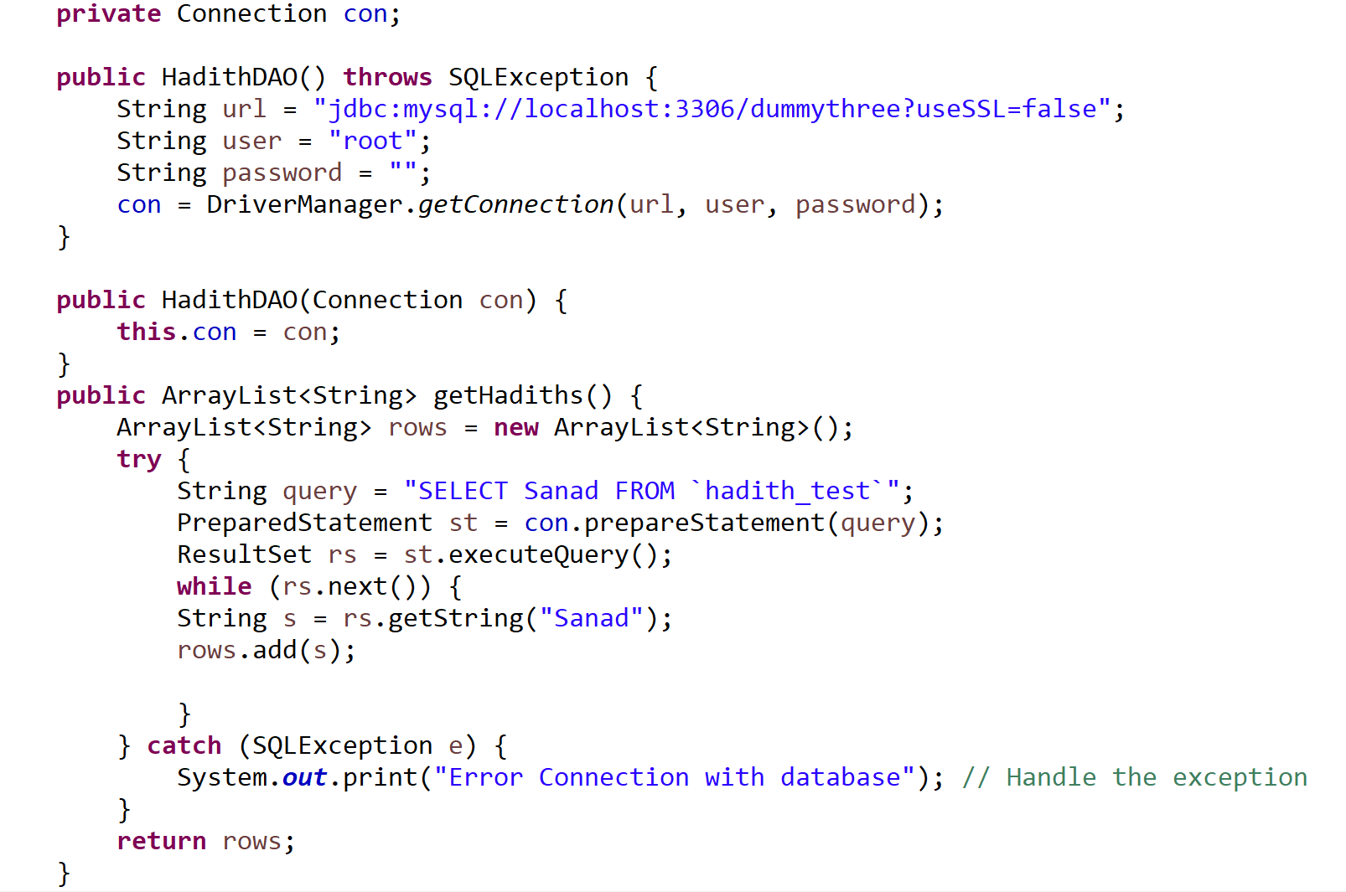
“Connection with database”
then we created the connection with database to load the ‘Hadith data’ to our java project.

Slide 15
Iteration-02
Narrator functions, control flow graph and test cases

Slide 16
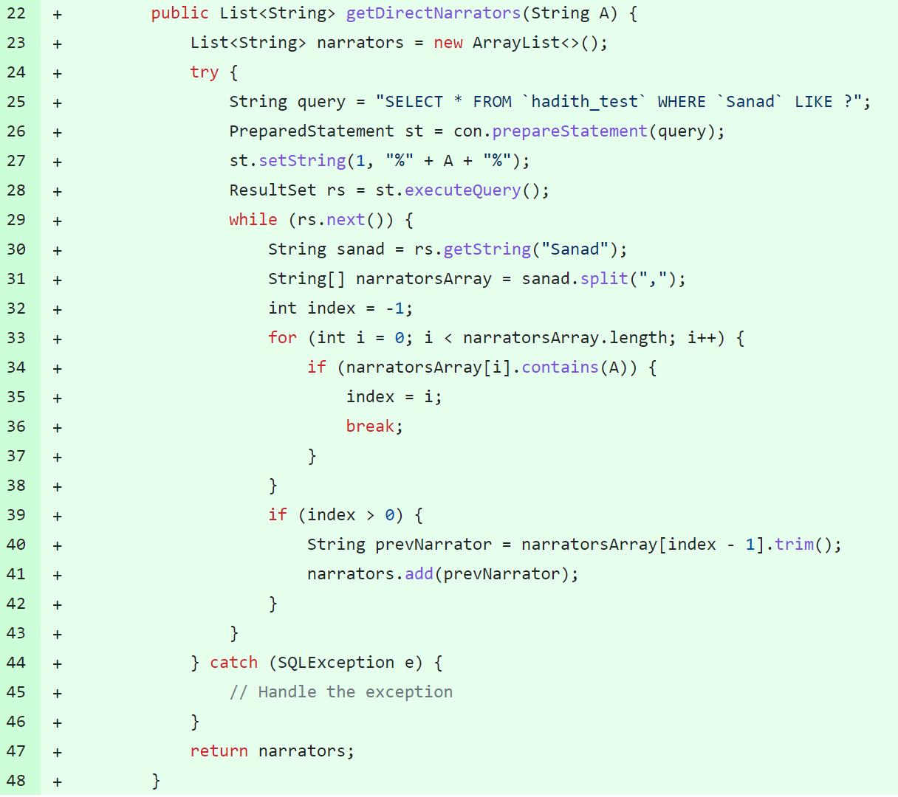
Getting all the narrators from database
By using ‘getDirectNarrators ’ function, we read all of the narrators from database for further working.

Slide 17
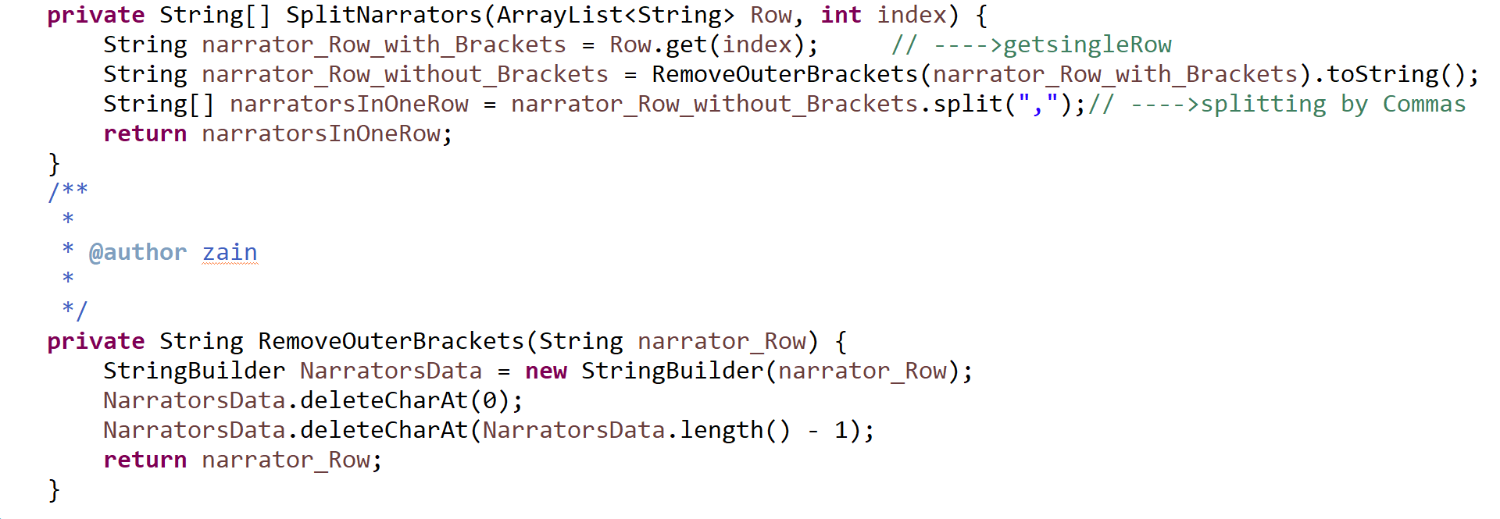
“Getting narrators of a single row”
Following functions removes the outer brackets and split the narrators by comma and returns all of the narrators in a single row.

Slide 18
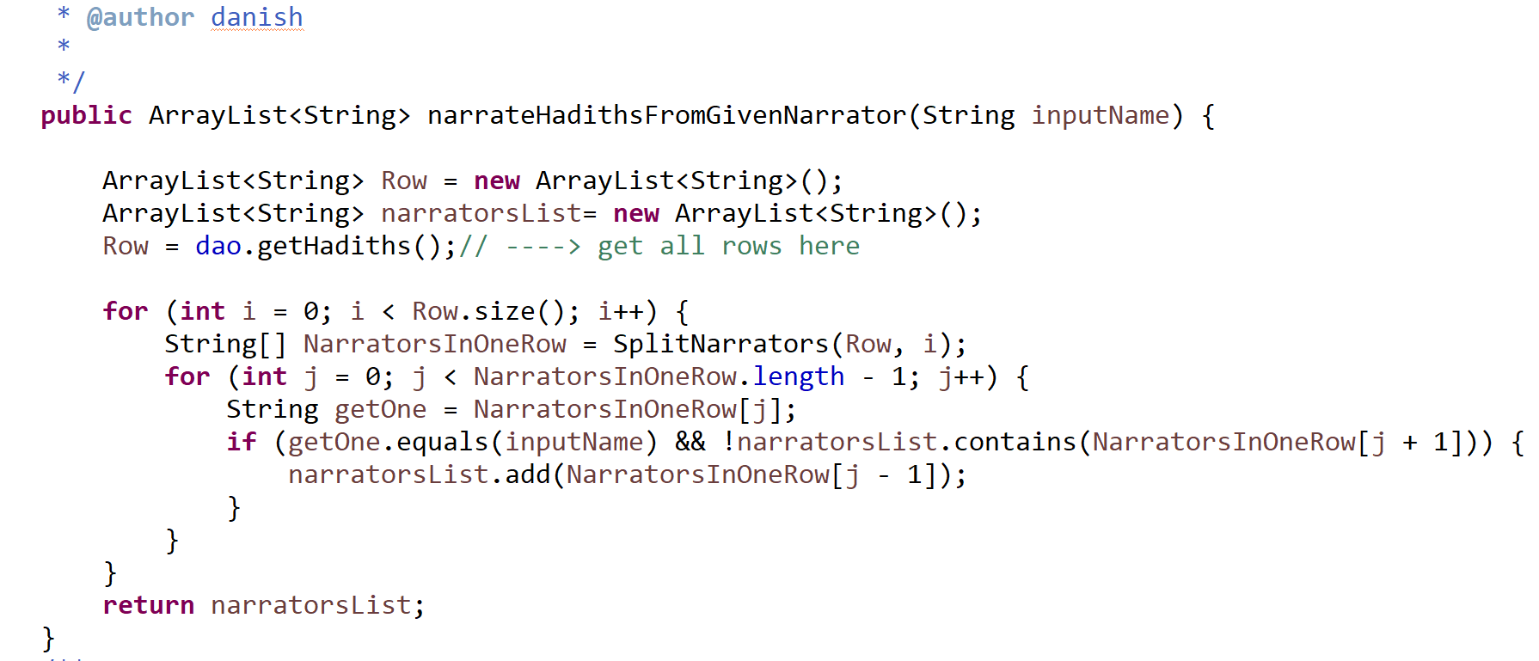
“List the narrators that directly narrate hadiths from a given narrator A”

Slide 19
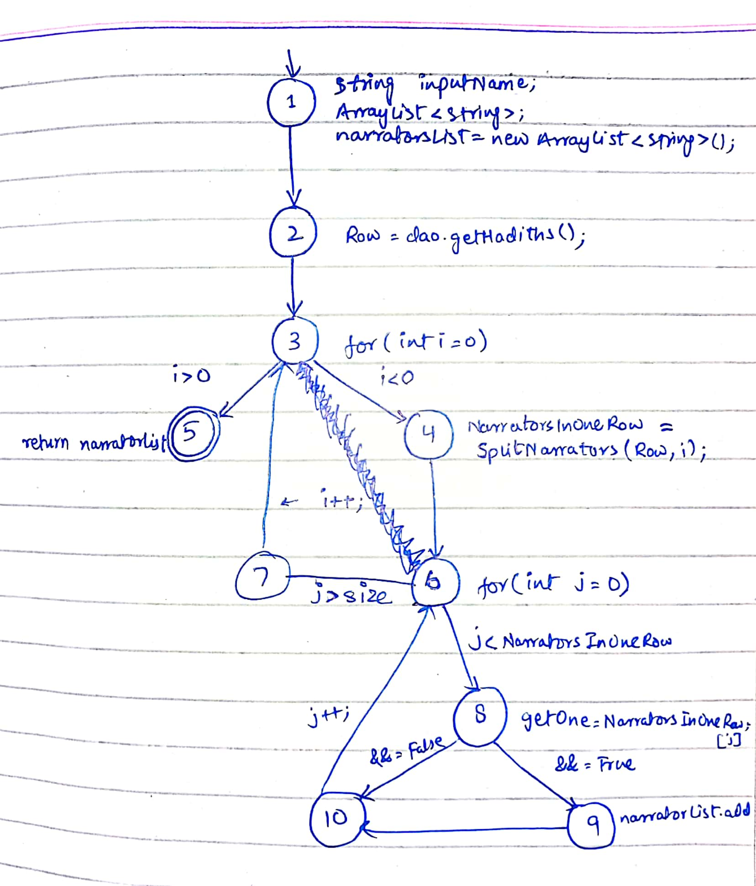
Control flow graph of
FROM NARRATOR
function

Slide 20
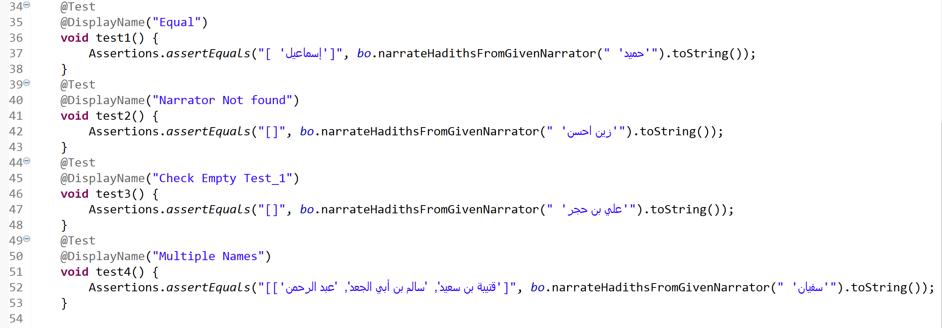
“Test cases for FROM NARRATOR function”

Slide 21
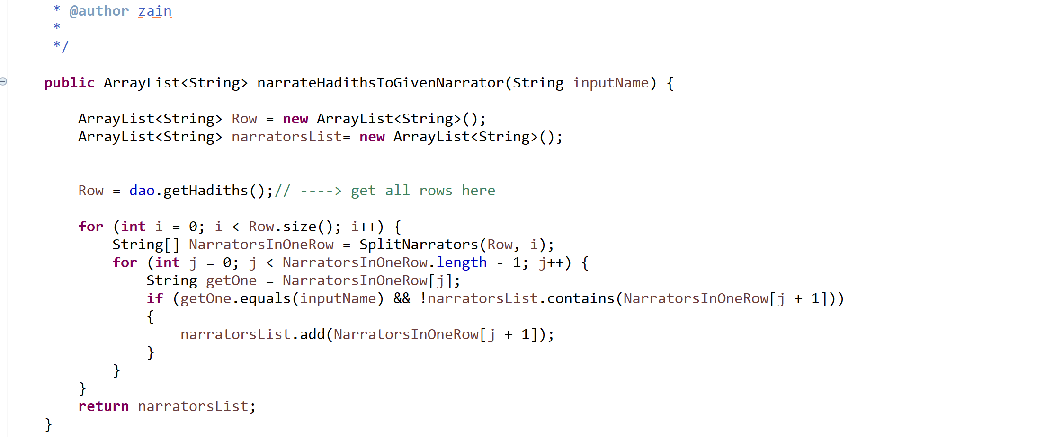
“List the narrators that directly narrate hadiths to a given narrator A”

Slide 22
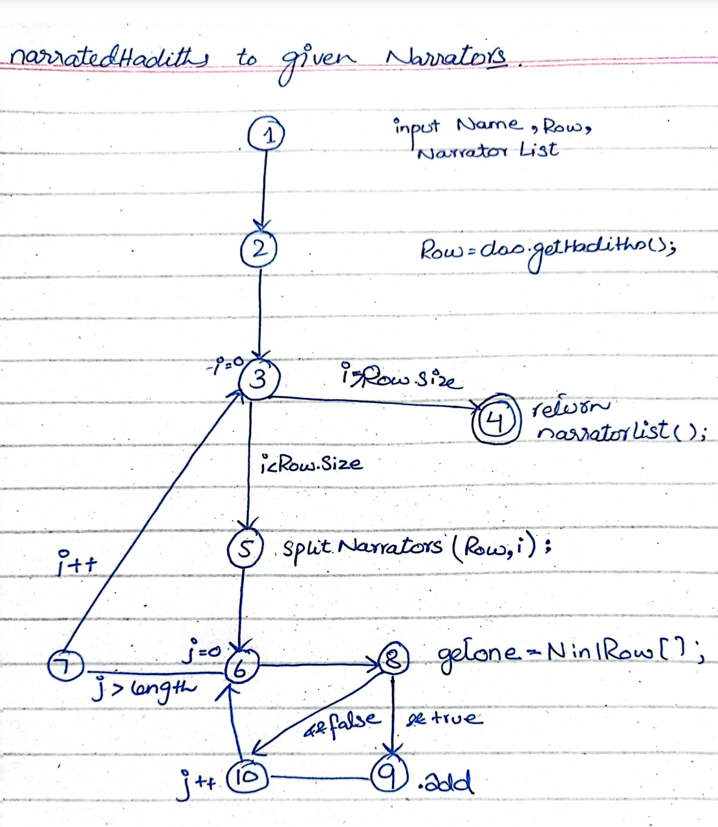
Control flow graph of
TO NARRATOR
function

Slide 23
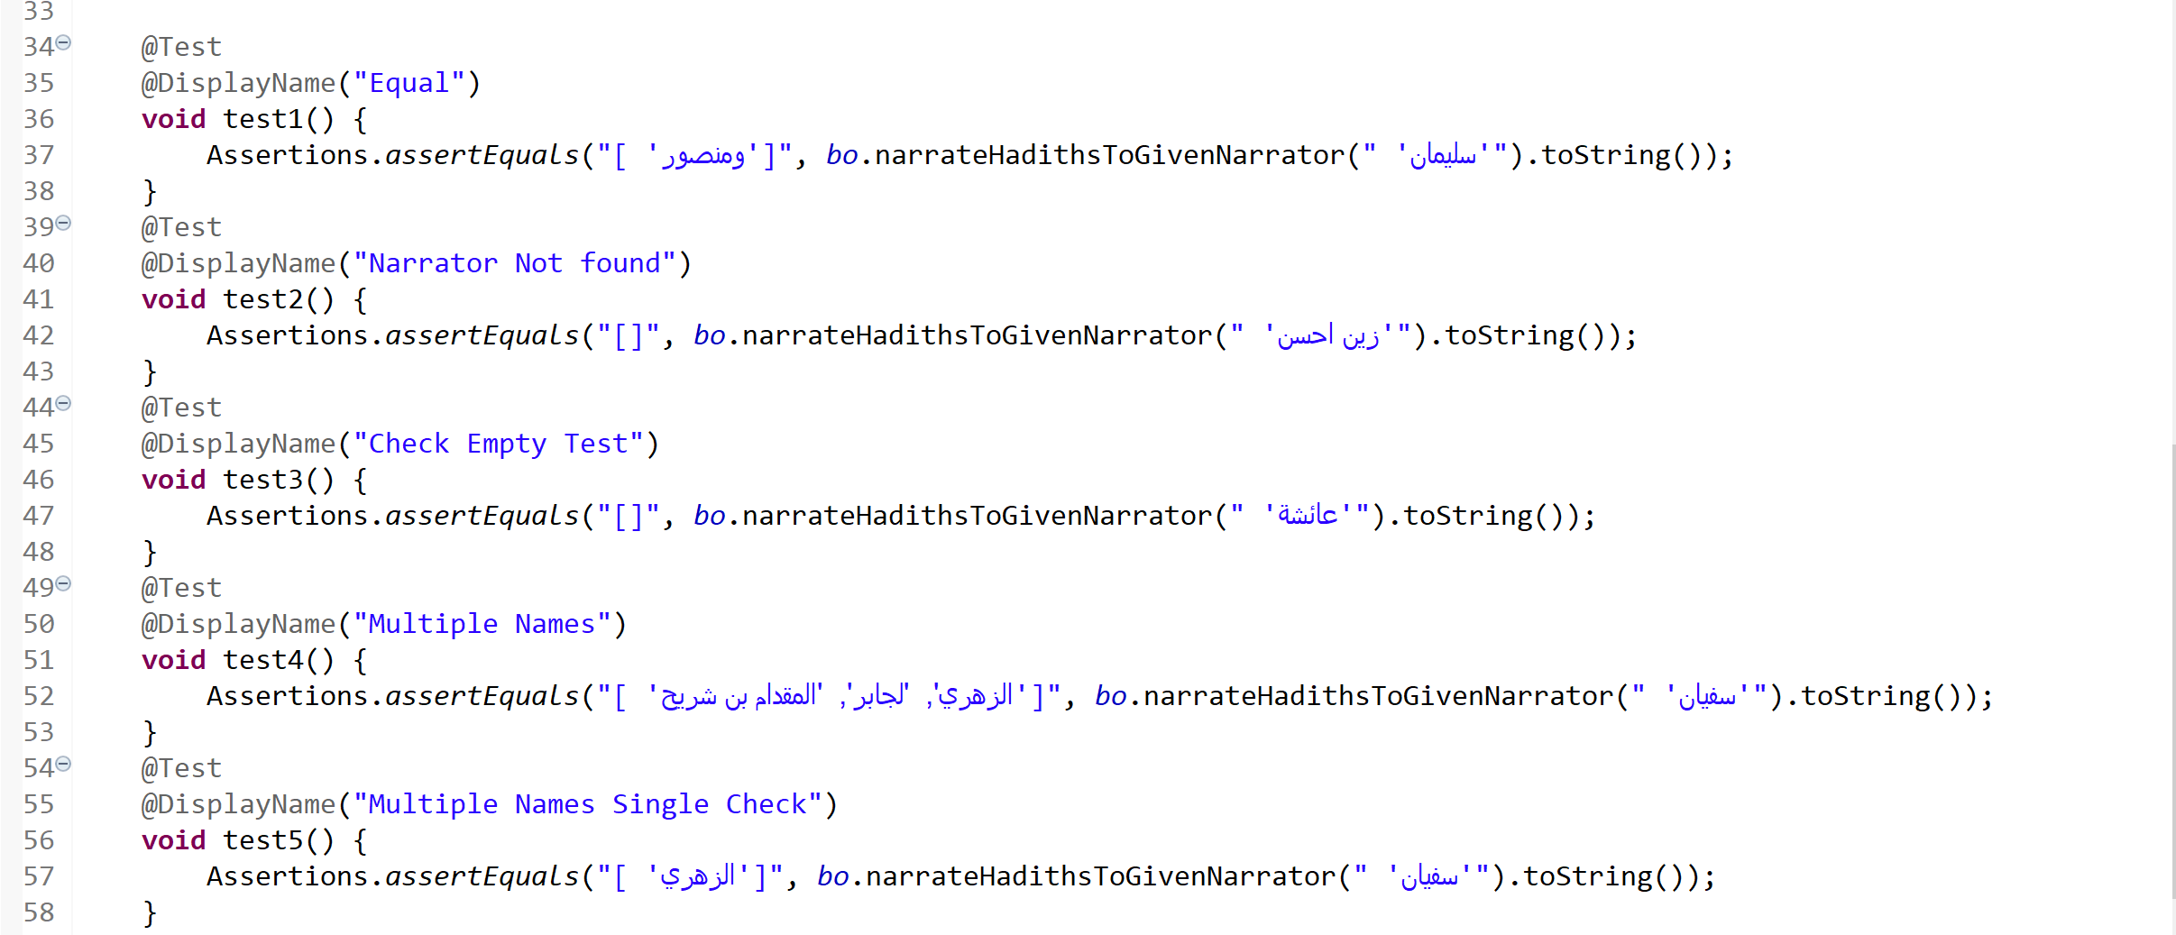
“Test cases for TO NARRATOR function”

Slide 24
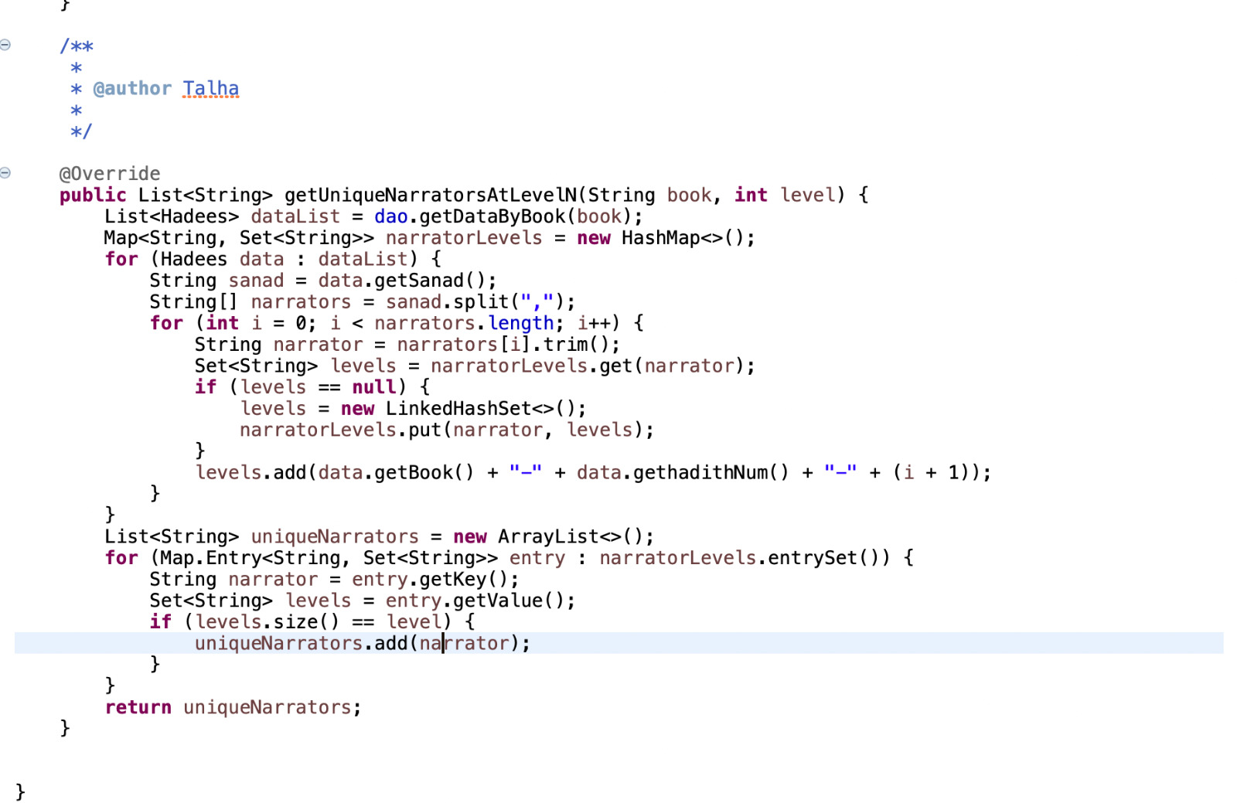
“List the unique narrators at level-n in a given book”

Slide 25
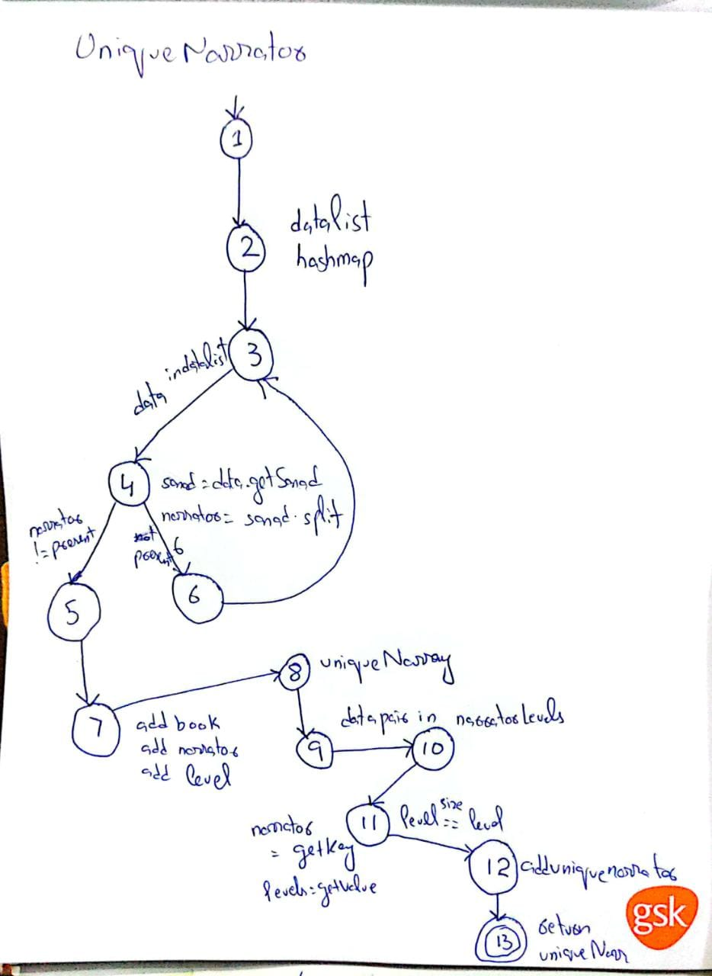
Control flow graph of
UNIQUE NARRATOR
function

Slide 26
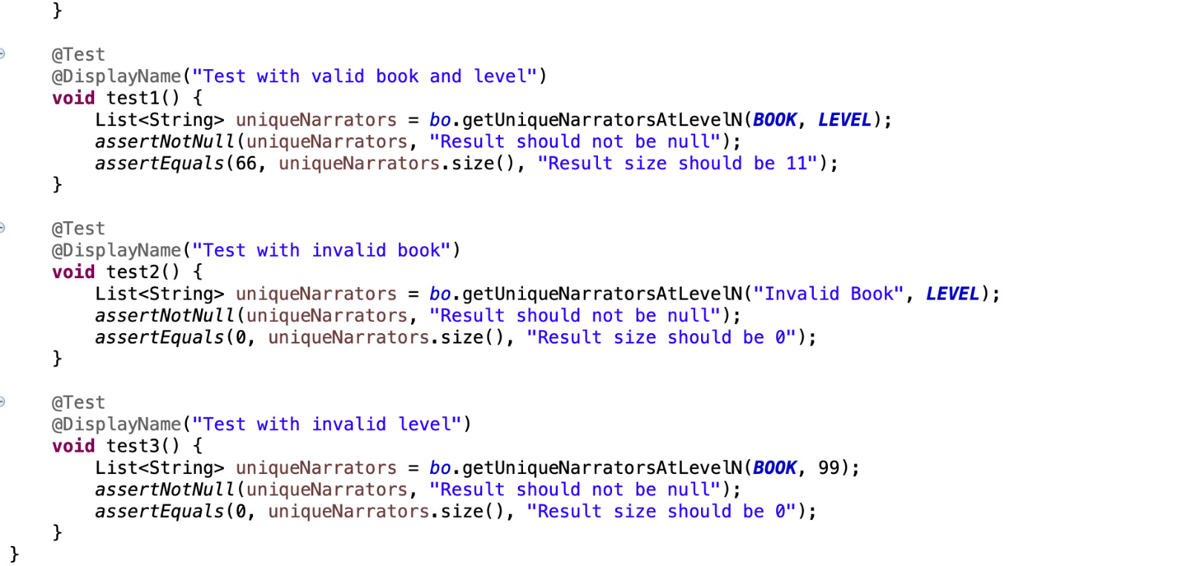
“Test cases for UNIQUE NARRATOR function”

